Slide 1

Design & Implement
a Relational Database
Practicum I
Group members: Jichi Ge, Wei Song, Yu Swe Zin Aung, Ziqi Fo

Slide 2

Table of Contents
01
02
03
04
05
Conceptual Model &
Relational Schema
SQL DDL statements &
Data Importation
SQL Query Development for Bird Strike Analysis
Bird Strikes Comparative Column Chart Creation
Bird Strike Deletion Stored Procedure Implementation
Part 1
Part 2&3
Part 4&5&6
Part 7
Part 8

Slide 3
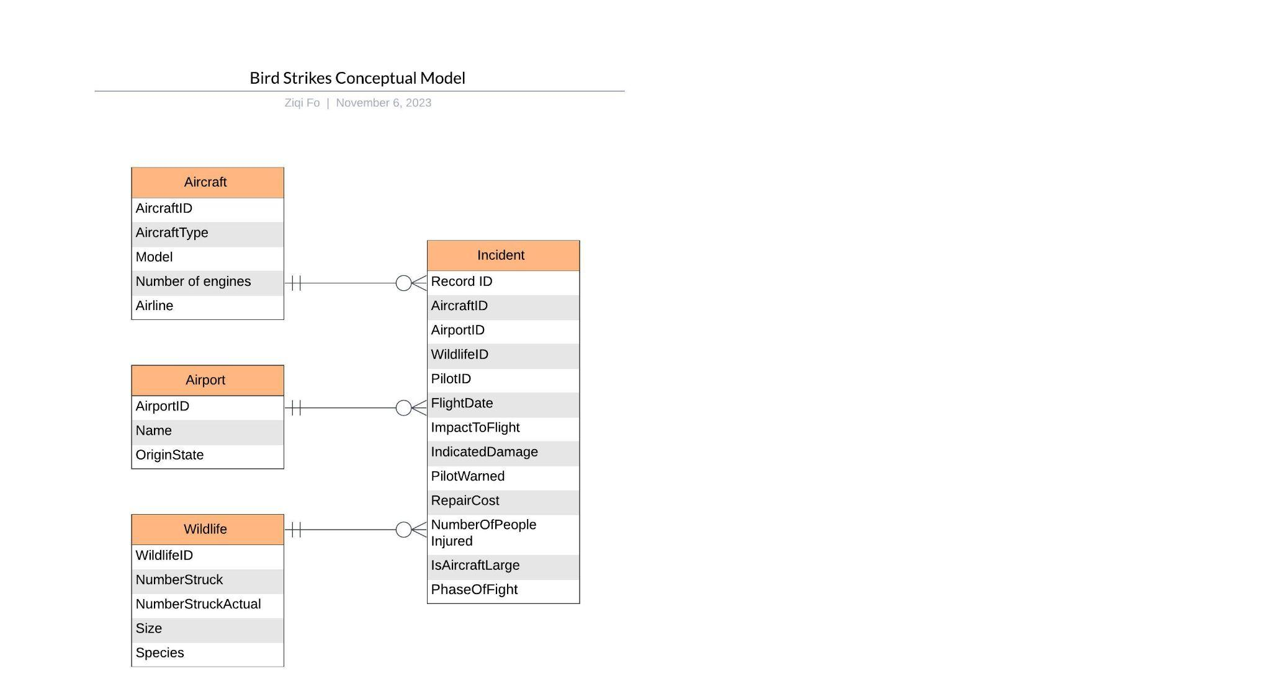
Conceptual Model
1
Overview of the Conceptual Model:
The conceptual model visualizes the structure of a database designed to record and analyze bird strike incidents.
Key Entities: Aircraft, Airport, Wildlife, and Incident.
Relationships: Defined by Primary Keys (PK) and Foreign Keys (FK) connecting various entities.
Next page!

Slide 4
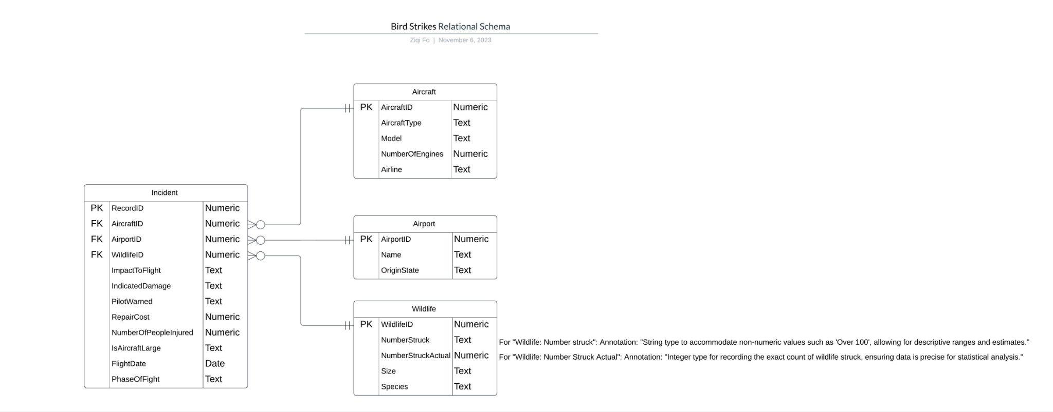
Relational Schema
1

Slide 5
SQL DDL statements & Data Importation
2

Slide 6
SQL DDL statements
Tables Overview:
Airport Table: Holds data about airports, with AirportID as a primary key.
Wildlife Table: Records wildlife incidents, identified by WildlifeID.
Aircraft Table: Lists aircrafts, where AircraftID is the primary key and NumberOfEngines is constrained to 1-4.
Incident Table: Contains incident reports linking all the above entities
Key Points:
Use of primary keys (PK) to uniquely identify table entries.
Enforcement of relationships through foreign keys (FK).
Column constraints to ensure data integrity (e.g., NOT NULL, CHECK constraints).

Slide 7
SQL DDL statements
Constraints & Relationships:
PK/FK Constraints: Ensure the relational integrity between tables.
CHECK Constraints: Validate data upon entry (e.g., NumberOfEngines, PhaseOfFlight).
Data Types and Defaults: Discuss the choice of data types like VARCHAR, INT, NUMERIC, BOOLEAN, and the use of defaults where applicable.

Slide 8
Data Importation
Slide 1: Data Cleaning
Remove all data rows where aircraft type is empty/null.
Remove all data rows where the number of engines is not between 1 and 4.
Slide 2: Data Processing
Generate a primary key, AircraftID, for the Aircraft Table.
Generate a primary key, AirportID, for the Airport Table.
Generate a primary key, WildlifeID, for the Wildlife Table.
Slide 3: Data Mapping
At the incident record level, map relevant foreign keys from Aircraft, Airport, and Wildlife Tables.

Slide 9
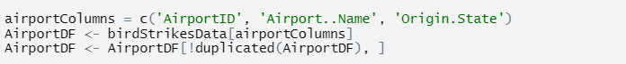
Data Importation
Step 4: Creating DataFrame
Create Aircraft, Airport and Wildlife dataframe with unique rows
Create incident dataframe

Slide 10
Data Importation
Step 5: Import data from DataFrame into the relevant Database table
Import into airport Table
Import into aircraft Table
Import into wildlife Table
Import into incident Table

Slide 11

SQL Query Development
3

Slide 12
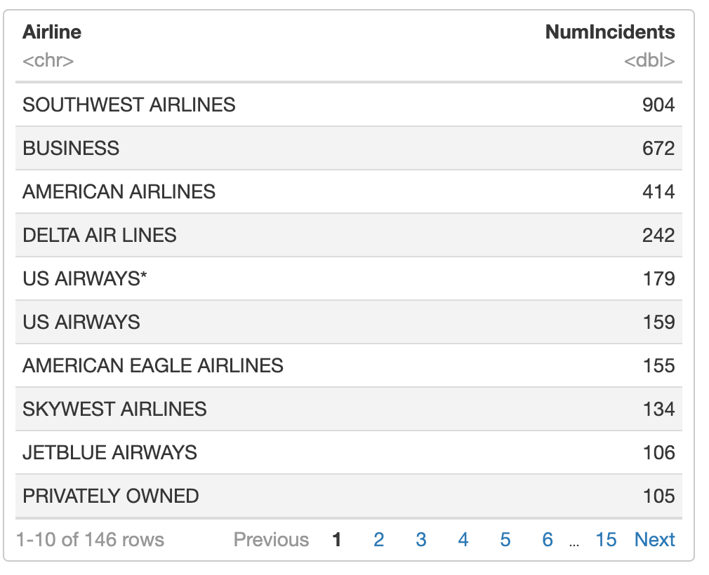
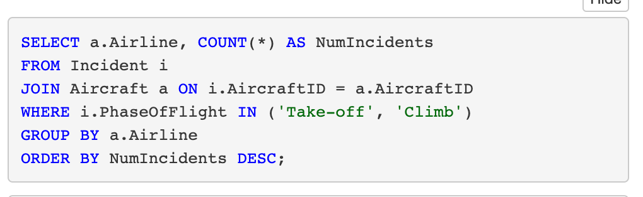
Analysis of Bird Strike Incidents
The number of bird strike incidents for each airline
upon take-off or climb (based on assumption that
us airways and us airways * as different airline)

Slide 13
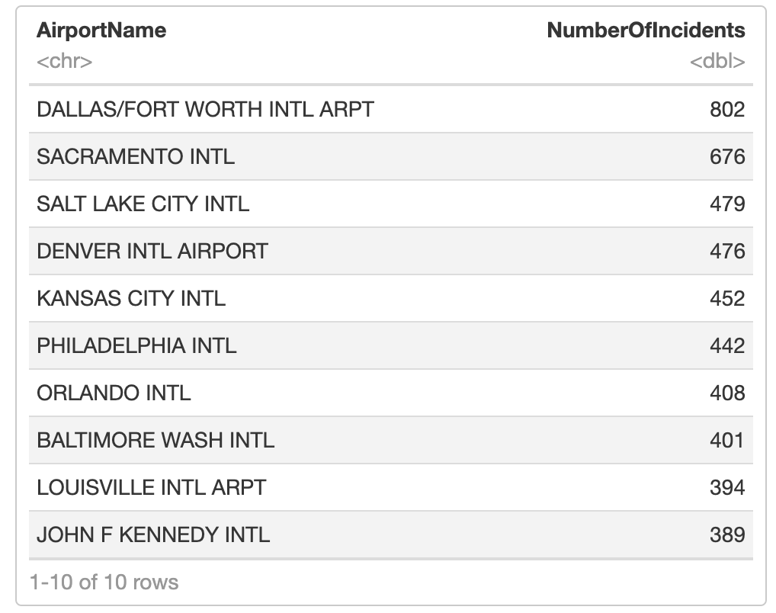
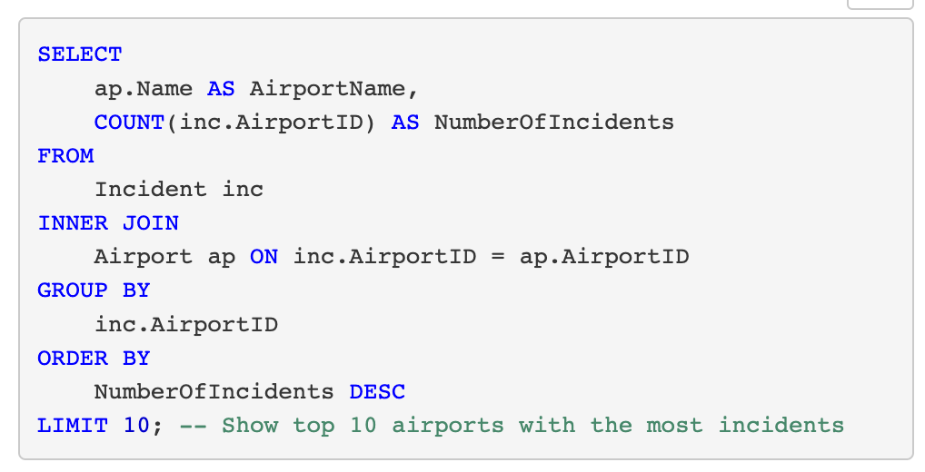
The airports that had the most bird strike
incidents(during any flight phase)

Slide 14
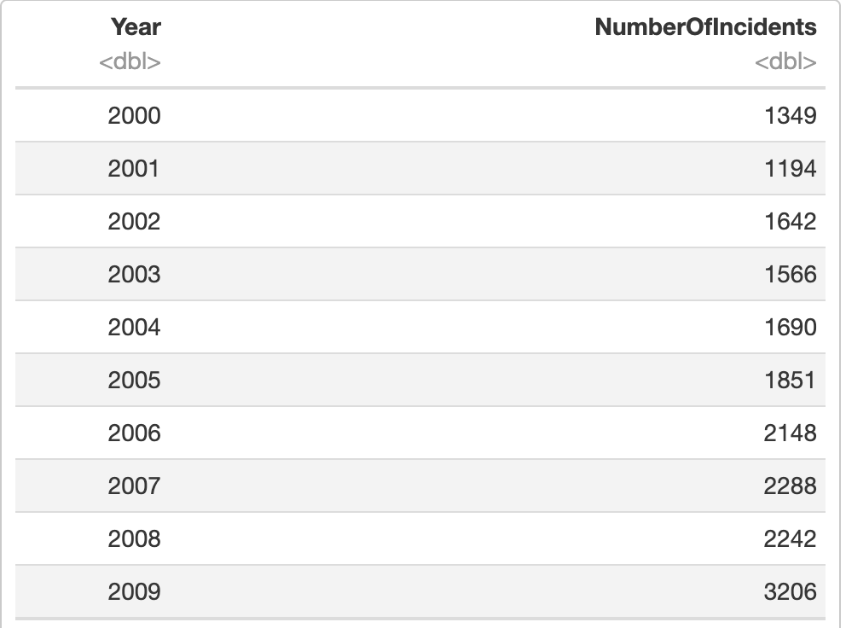
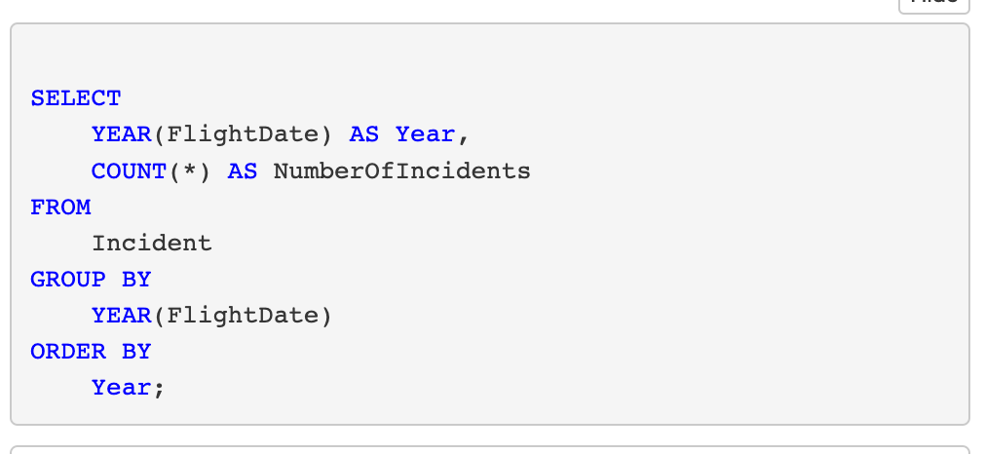
The number of bird strike incidents by year
include all airlines

Slide 15
Bird Strikes Comparative Column Chart Creation
4

Slide 16
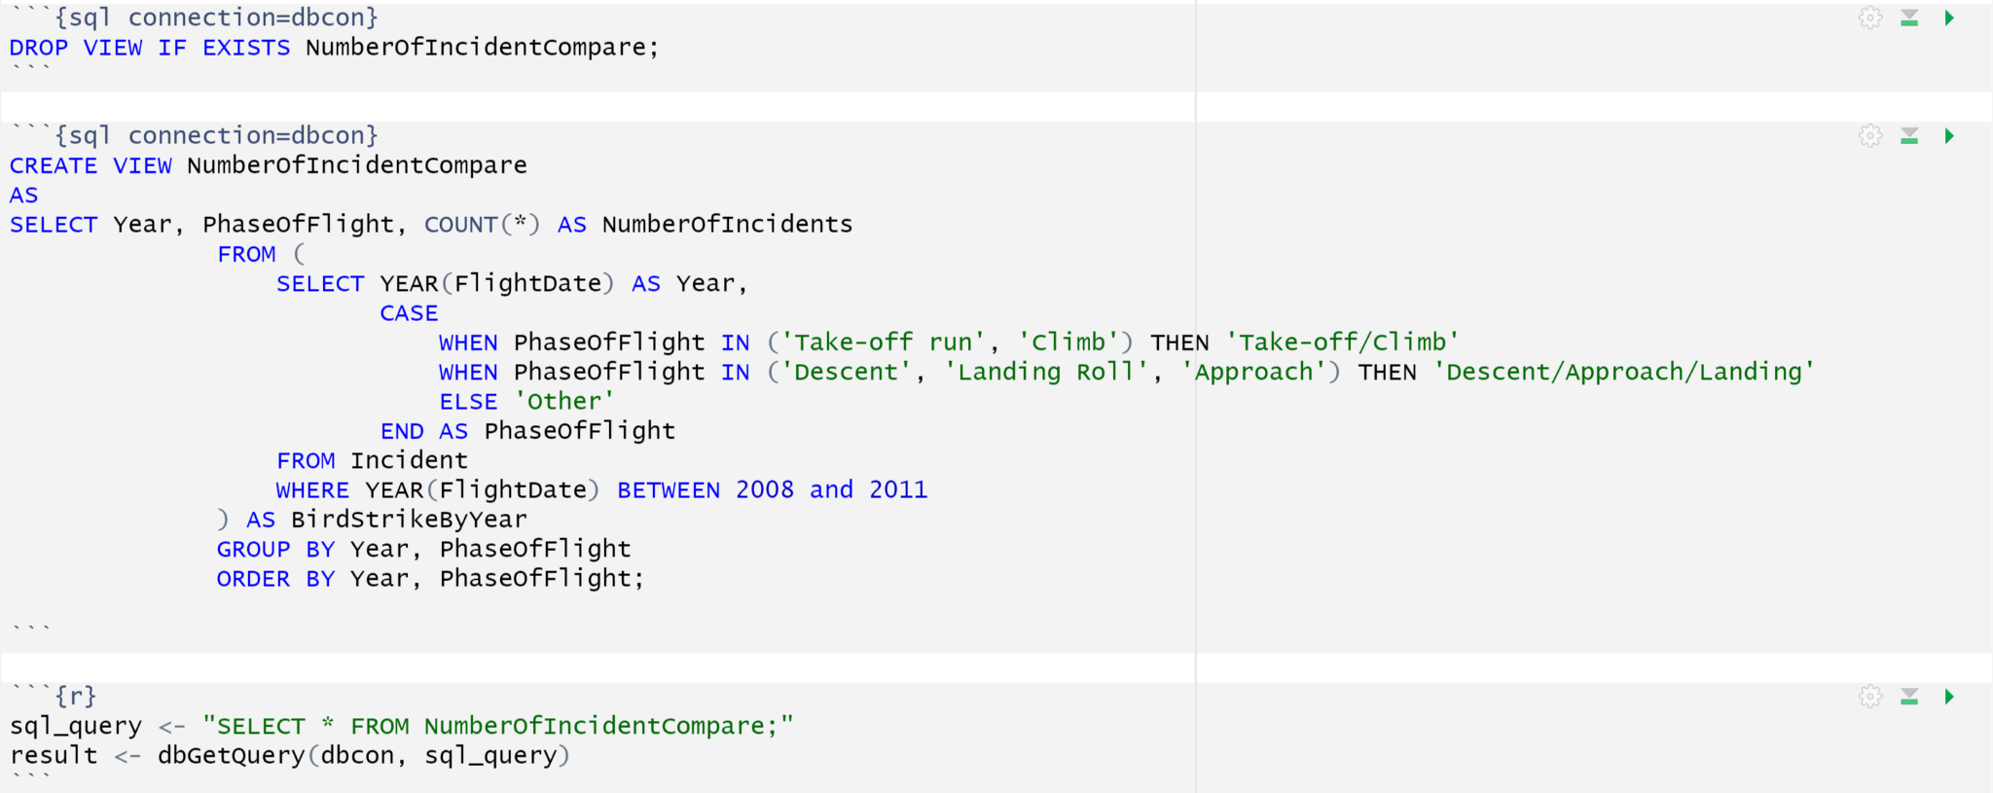
SQL Query

Slide 17
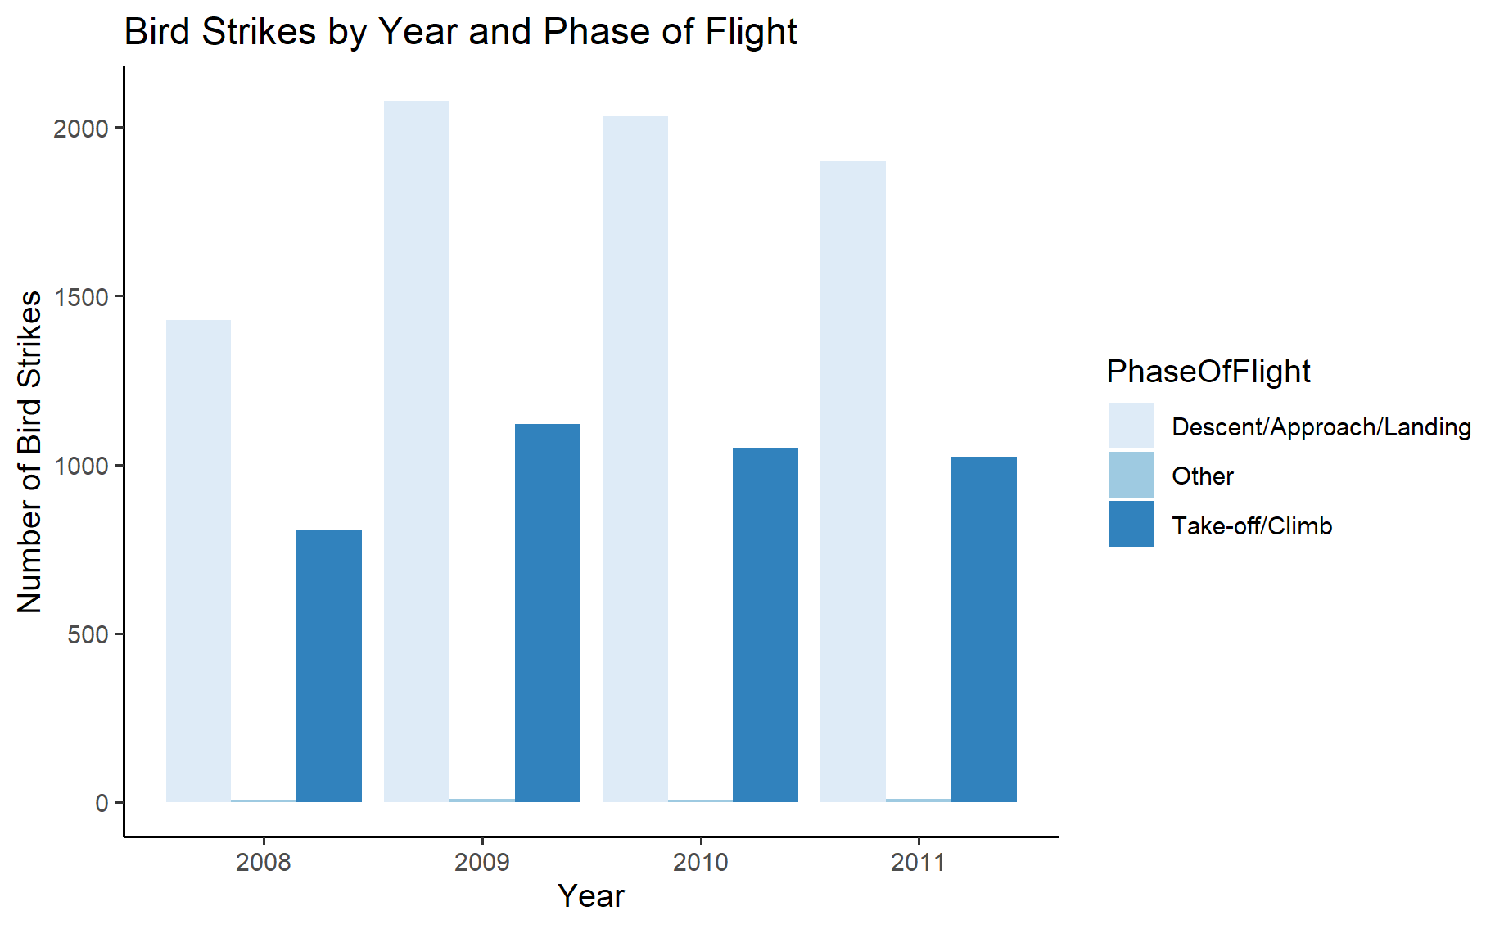
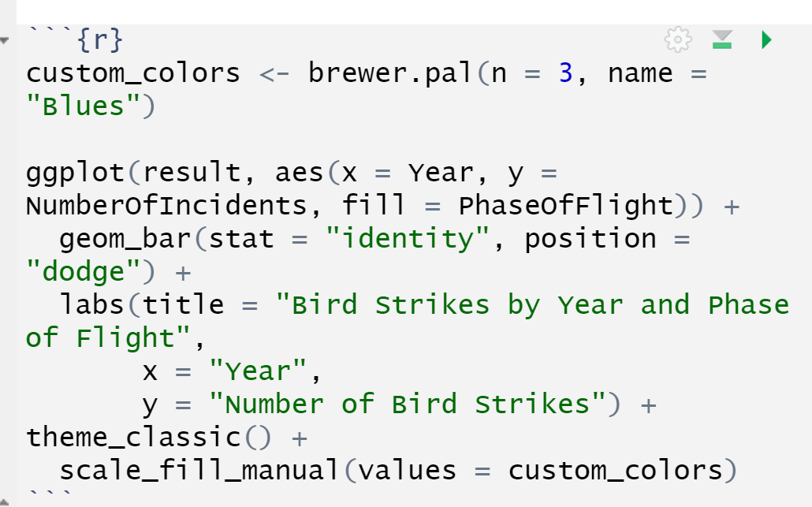
Bird strikes chart

Slide 18
Bird strikes chart
Other phase means the flight is in the airport
Bird strike is mainly happen during take-off/climbing and during descent/approach/landing
In year of 2009, the bird strike incident increased in both descent and take-off phase
In the following years the bird strikes keep decreasing in both phase of flight

Slide 19
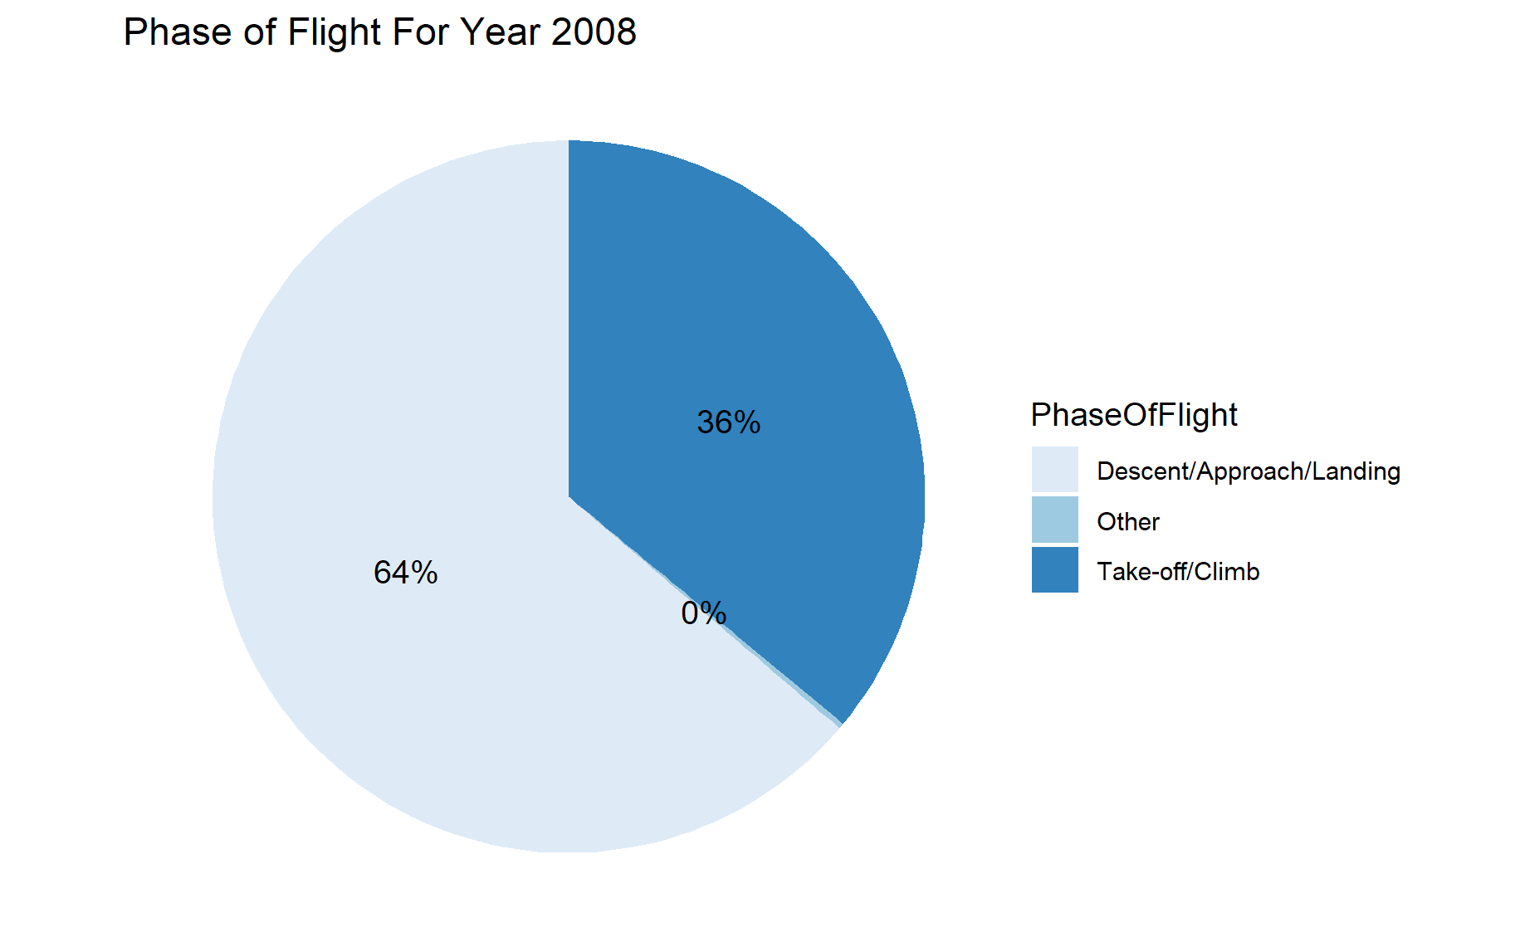
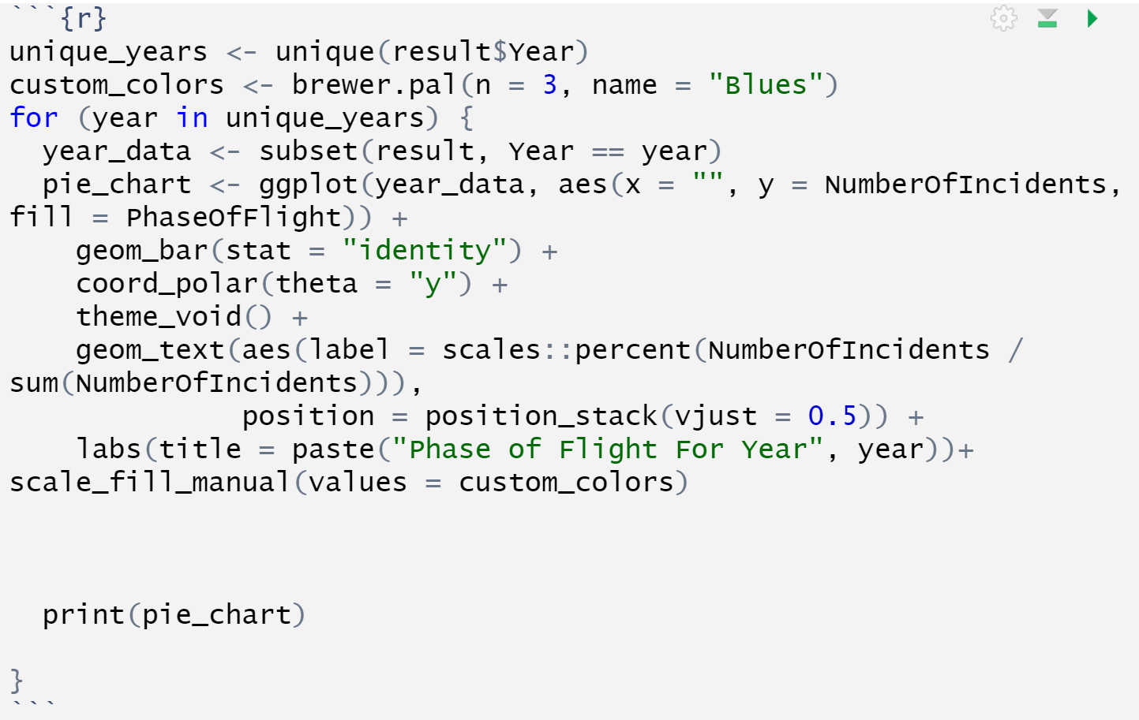
Bird strikes chart

Slide 20
Bird strikes chart
It is more dangerous during landing than take-off from 2008 to 2011
The relative ratio for the phase of flight in the bird strike incident is stable

Slide 21
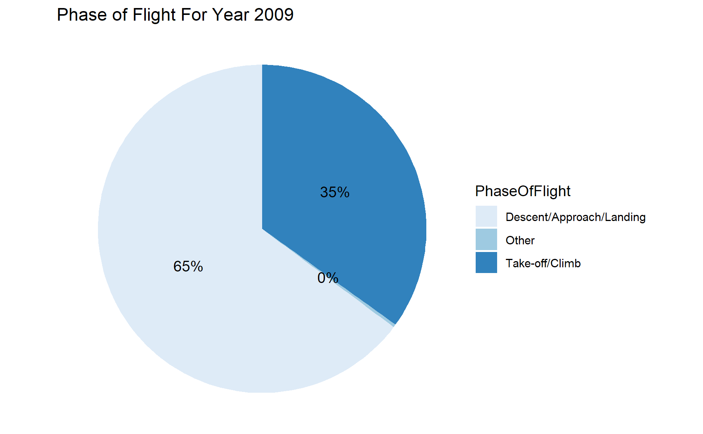
Bird strikes chart

Slide 22
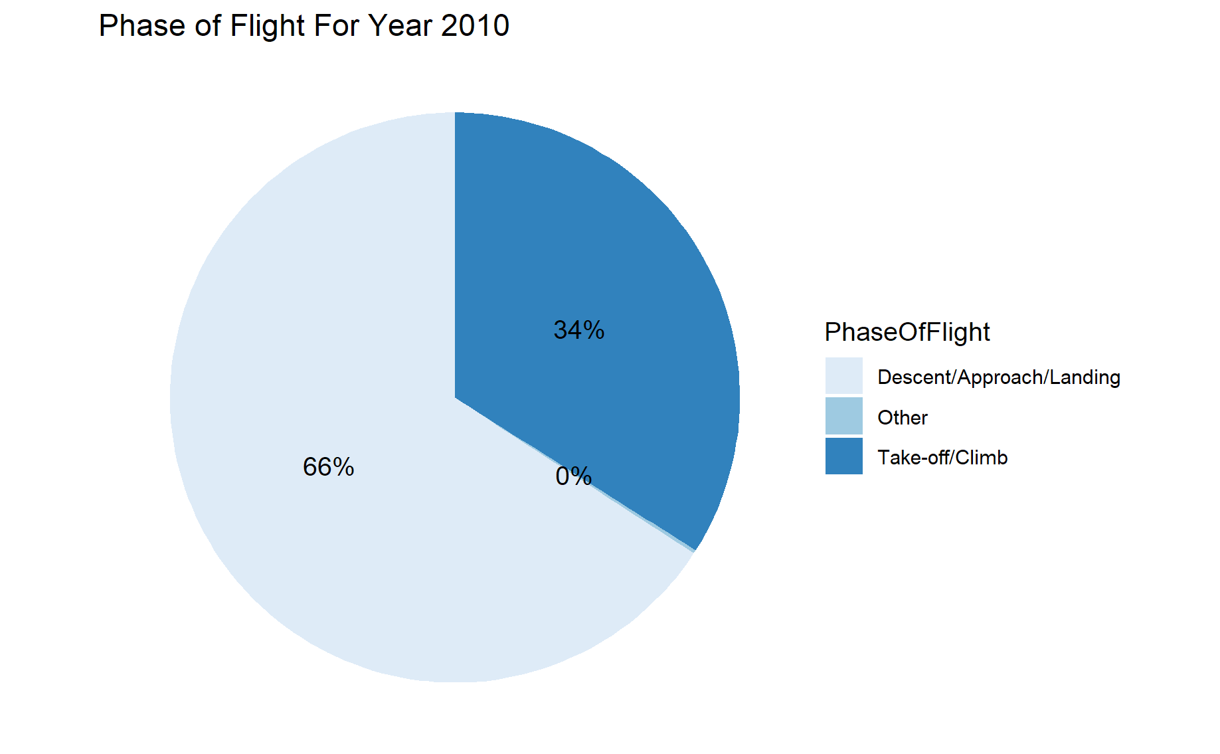
Bird strikes chart

Slide 23

Bird strikes chart

Slide 24
Bird Strike Deletion Stored Procedure Implementation
5

Slide 25
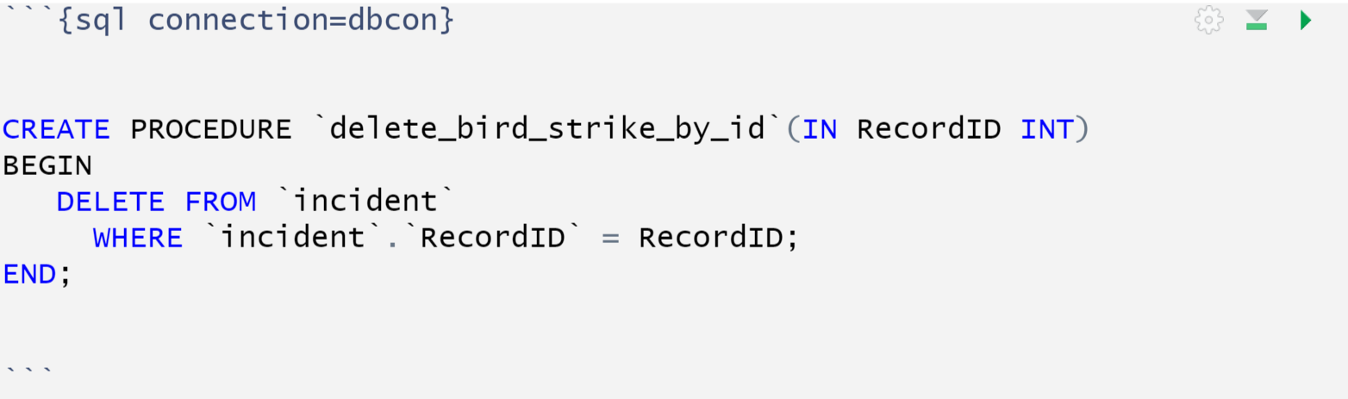
create a stored procedure
create a stored procedure that can delete an incident with an input of RecordID from the table incident

Slide 26
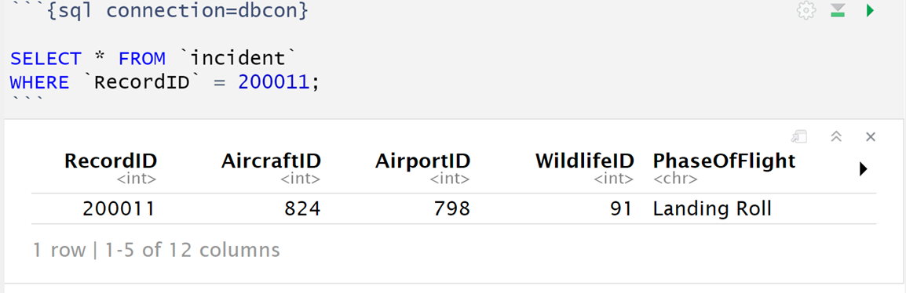
Show stored procedure
Before we call the stored procedure, there is an incident of ID 200011

Slide 27
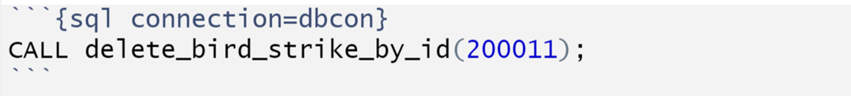
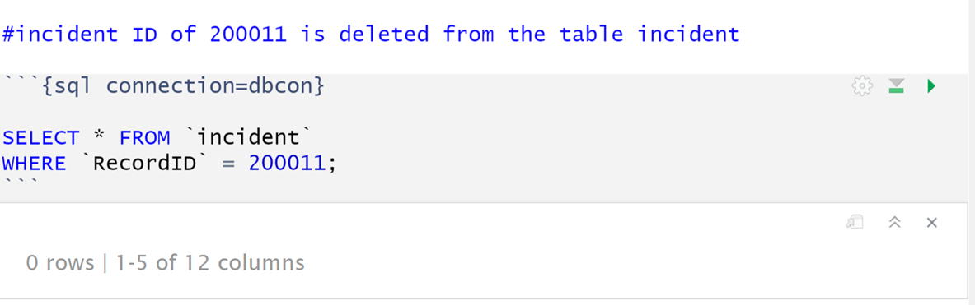
Call the stored procedure
Call the stored procedure
The incident with an RecordID of 200011 is gone

Slide 28

Thank you!

